Slide 1
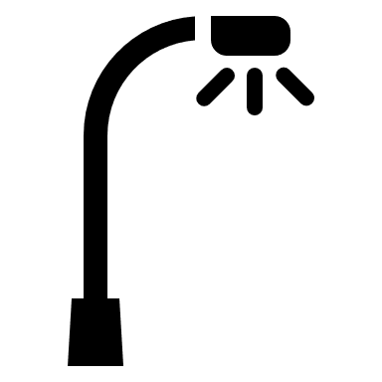
Turning night into day – Effect of skyglow on bat activity
A master’s thesis in Landscape Ecology
at Stockholm University
Notes:
Have you looked up into the clear night sky and wondered: „where did the milky way go?“ Then you have something in common with 1/3 of the global population, who is not able to see the milky way due to a polluted night sky ⁽¹⁾

Slide 2
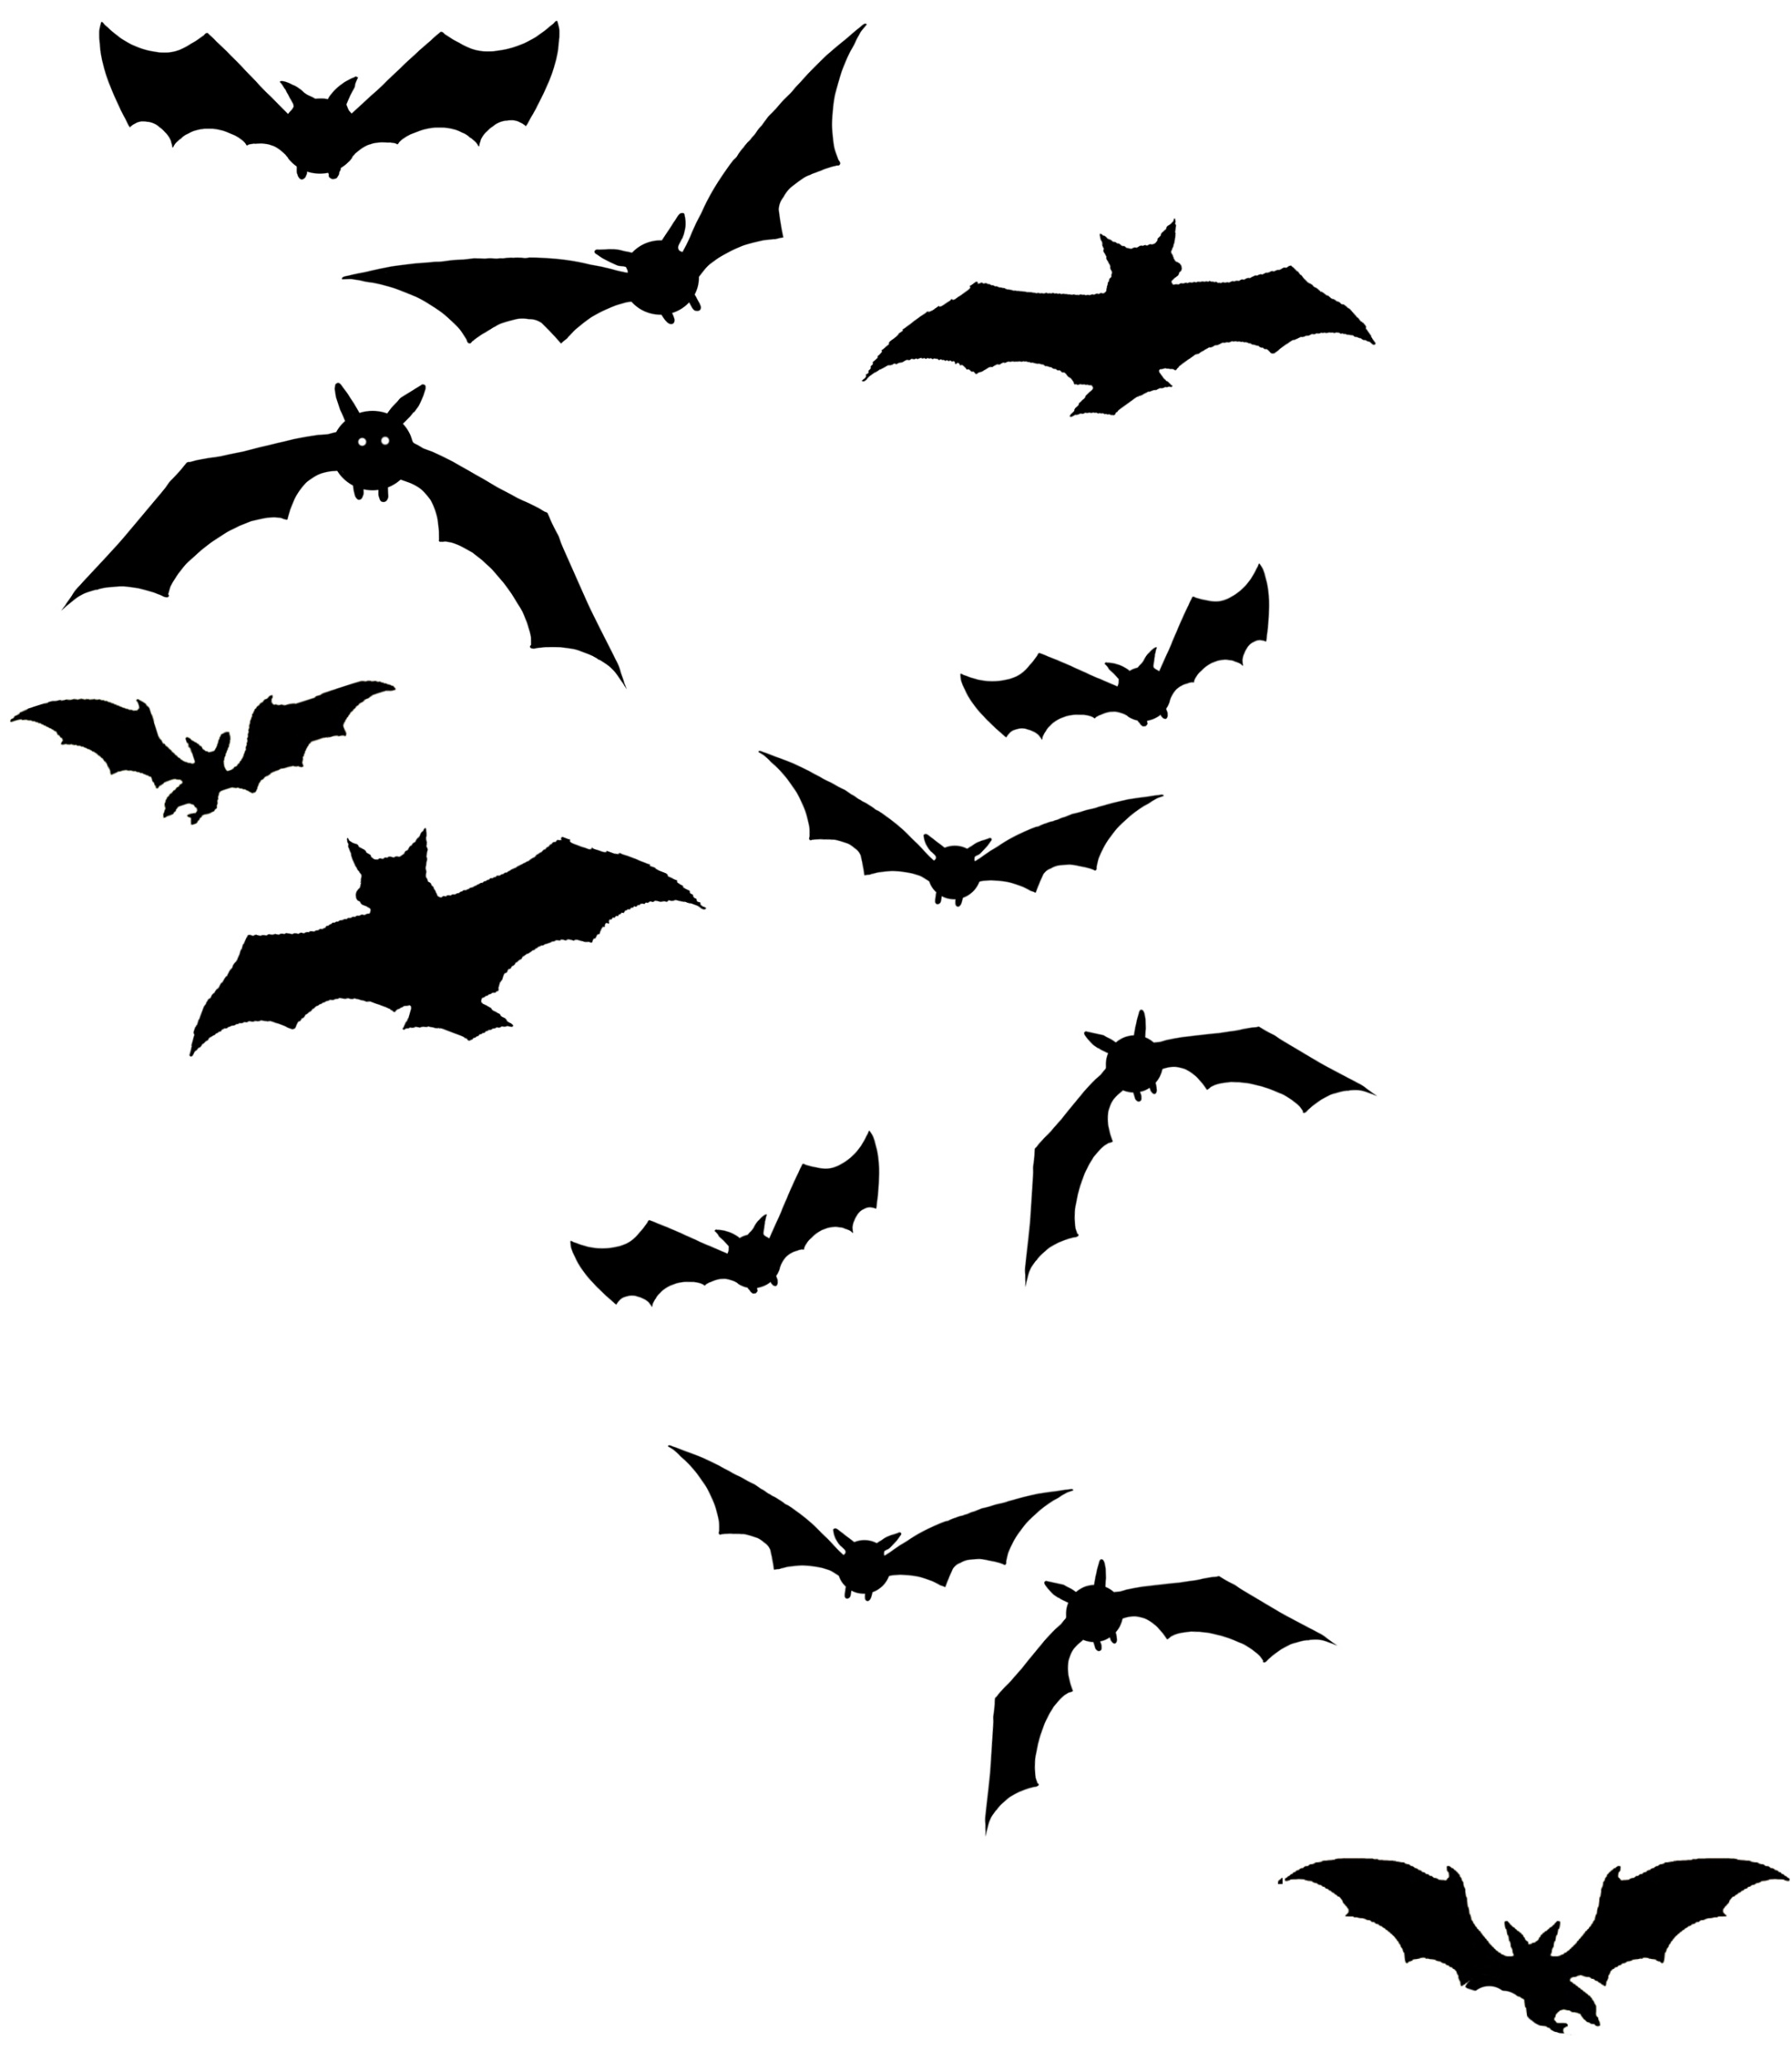
Agenda
Impact of light pollution
Study design
Preliminary results
Outlook

Slide 3
Impact of light pollution: skyglow
Studies mostly on direct light pollution from point sources
Skyglow = brightness of night sky caused by backscatter of artificial light
88 % of Europe experiences glowing night skies⁽¹⁾
→ need to understand effects
Notes:
Expansion of settlements, transportation networks & industry comes with expansion of light pollution caused by them
Not going into general light pollution
Most studies on bats consider effects of direct light from point sources such as street lamps
negative impact for bats at roosts and drinking sites⁽³⁾ as well as distribution of a generalist species (P. pipistrellus) on landscape scale⁽⁴⁾
open-/edge-space foraging bats might take advantage⁽³⁾
Skyglow definition
Immense spatial distribution and effects of light pollution from point sources stress the need for research on effects of Skyglow on bats
‘light-tolerant’ species negatively affected by skyglow⁽²⁾ = French researcher team published results of nationwide study: ‘light-tolerant’ species affected by skyglow⁽²⁾

Slide 4
Study Design
→ P. pygmaeus & M. daubentonii
AudioMoth detectors
Forest structure variables
Landcover data
Global skyglow dataset⁽¹⁾
Processed with Kaleidoscope Pro (v 5.4.7)
r = 15 m
Landscape r= 2 km
15x
Notes:
Design for comparison of light sensitive and light tolerant species
Recorded 3 nights within 3 weeks in July
Forest Stand: Number of Trees, Diameter at breast height (Mean), Standard Deviation of DBH as proxy for structural complexity (Neumann and Starlinger, 2001 http://dx.doi.org/10.1016/S0378-1127(00)00577-6), Canopy Height, Number of Shrubs
Landscape Level: Percentages of Landcover: Water, Forest (Decid./Conif.), Urban, Open Land) using National Landcover Database (=Nationell Marktäckedata)
Skyglow: From world atlas 2015 (Falchi et al 2016), resolution = 30 arc sec (~470m)

Slide 5
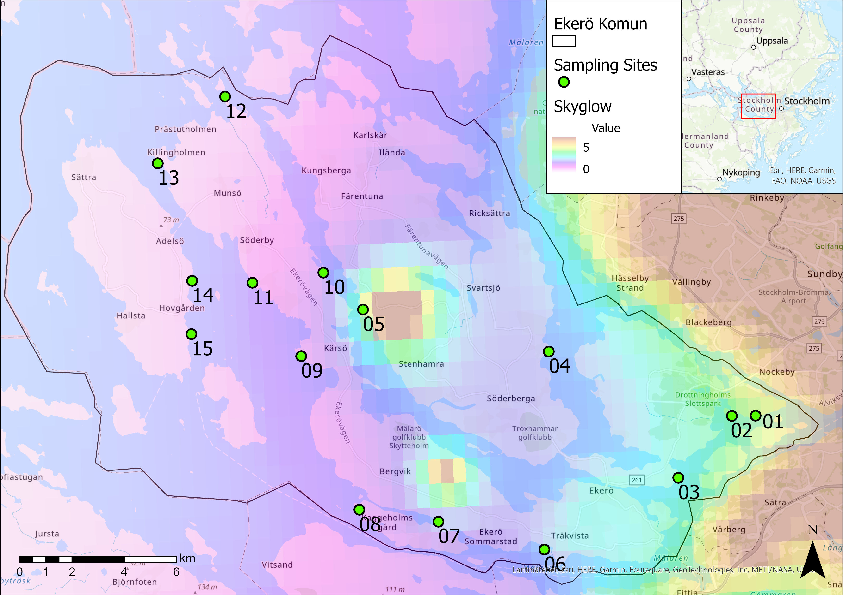
Study Design
Range:
0.4 – 3.6 mcd/m²
Max Sthlm:
~9 mcd/m²
Notes:
Study Area = Ekerö Komun on The Mälar Islands, west of Stockholm
Criteria for site selection: Deciduous forest next to open water surface, no urban area/houses in immediate vicinity (direct light impact), clear sight on water (no reed belt/opening in reed belt)
Used National Landcover Database and BIOTOPE SE (based on satellite images amongst all)
Artificial Brightness range: 0.4 (#13)– 3.6 (#05: large greenhouse for vegetable and herb production) mcd/m² (megacandela per squaremeter)

Slide 6
Preliminary (!) results
57,400 identified calls
41,200 P. pygmaeus → so far included in analysis
8,300 M. daubentonii → ID not checked yet
No statistics at this point, but nice figures ☺
Notes:
P. pygmaeus: 5,000 < 75% match ratio

Slide 7
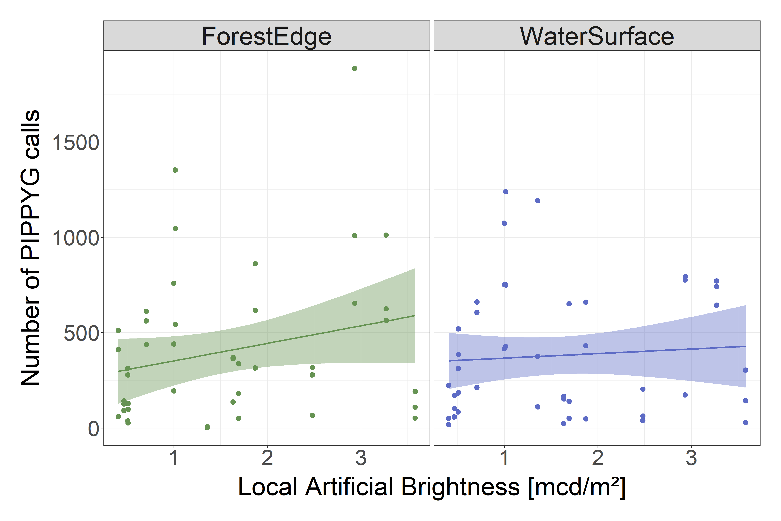
Preliminary (!) results: activity
Notes:
Number of passes from P. pygmaeus (pass = bat call with 2 or more pulses and/or social call)
Brightness at site (local scale)

Slide 8
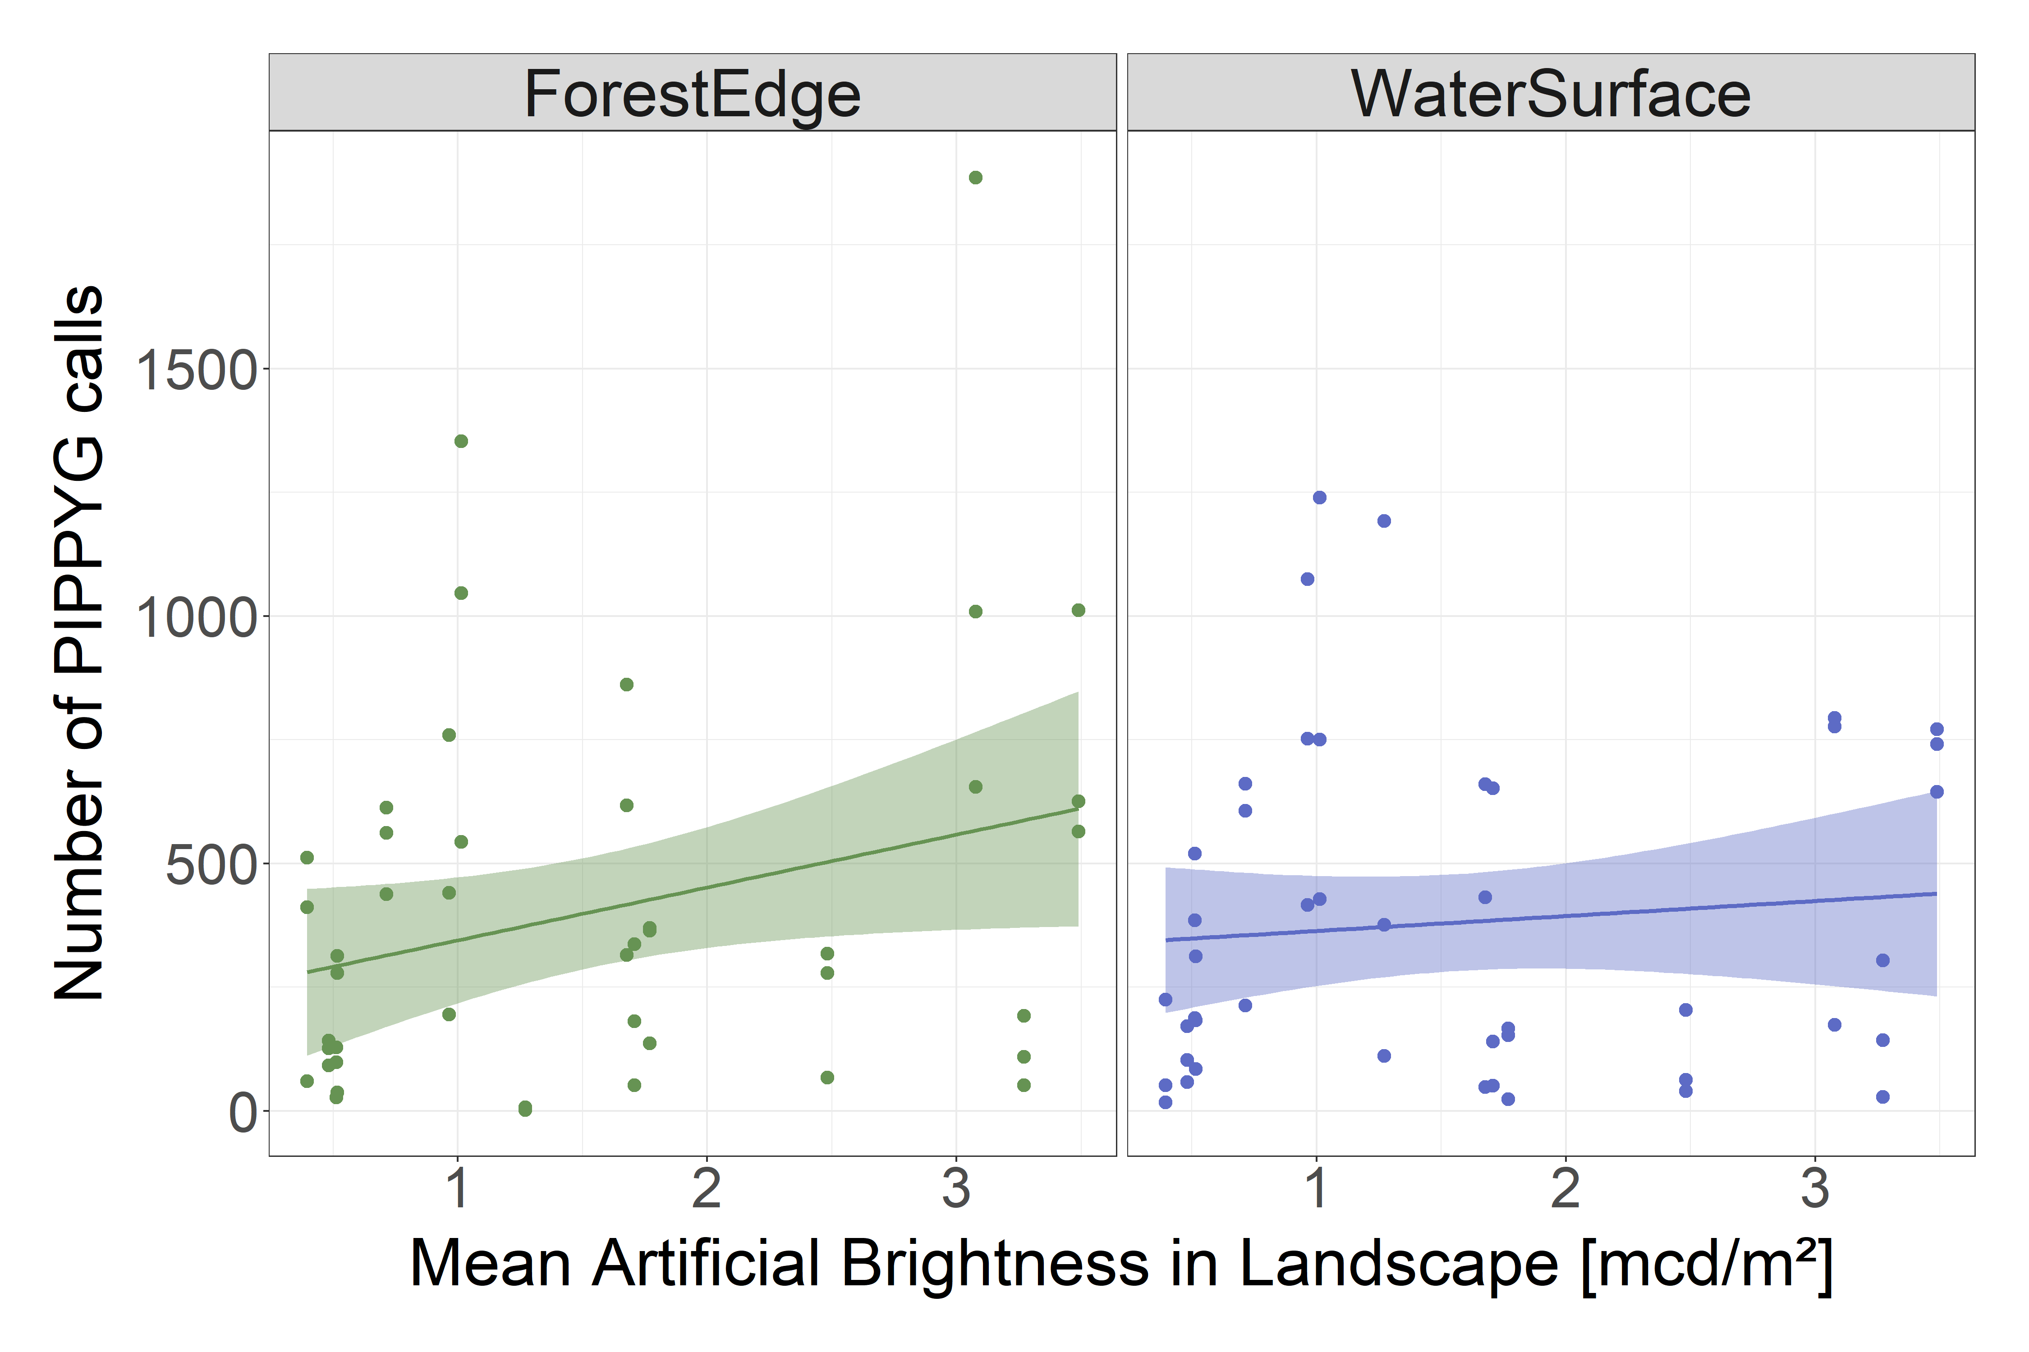
Preliminary (!) results: activity
Notes:
Mean brightness at landscape scale
Points don‘t really lie within confidence intervall → Brightness probably not statistically relevant
No big difference between two habitats
only trend differs
might indicate Soprano Pipistrelle prefers to forage in the shelter of vegetation structure within Forest Edges under brighter night skies

Slide 9
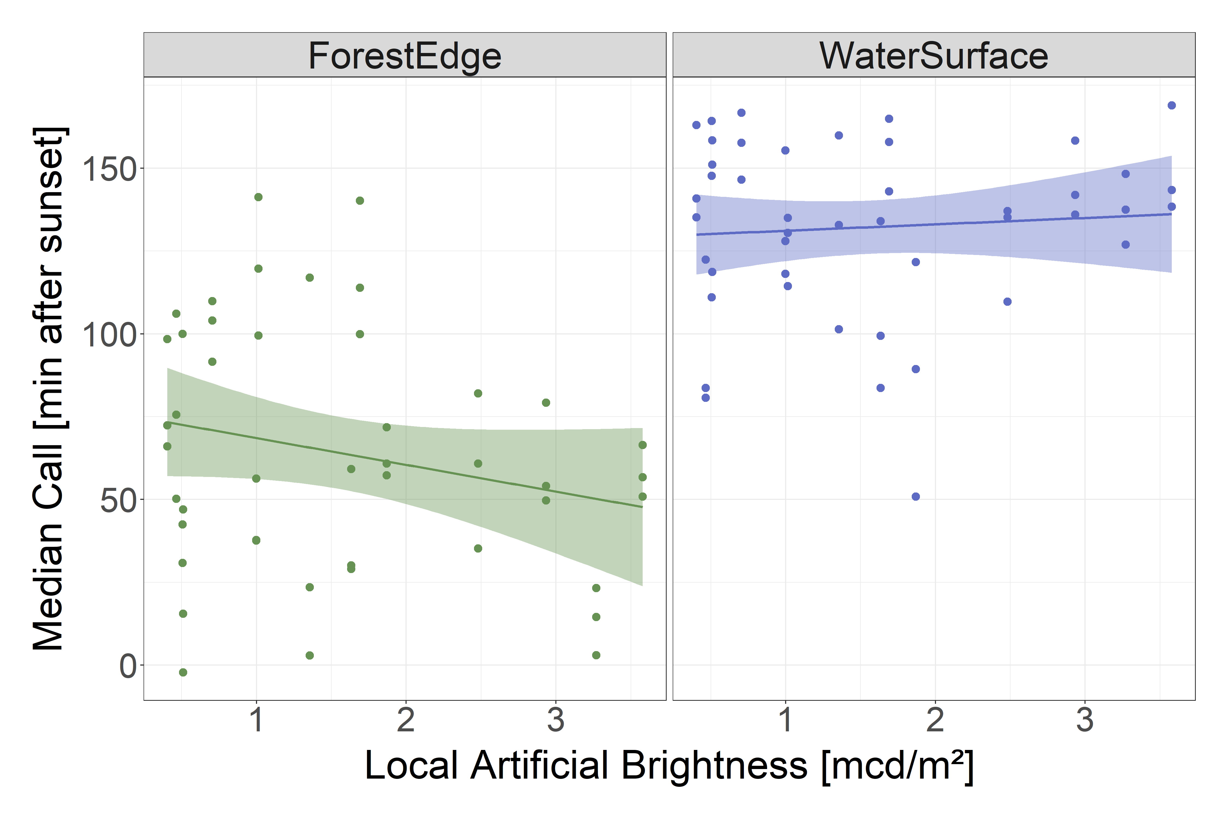
Preliminary (!) results: Median call in first 3.5h
Notes:
First 3.5 h of the night cover the first of two peaks for bat activity
Same picture: no big difference between local scale and landscape scale

Slide 10
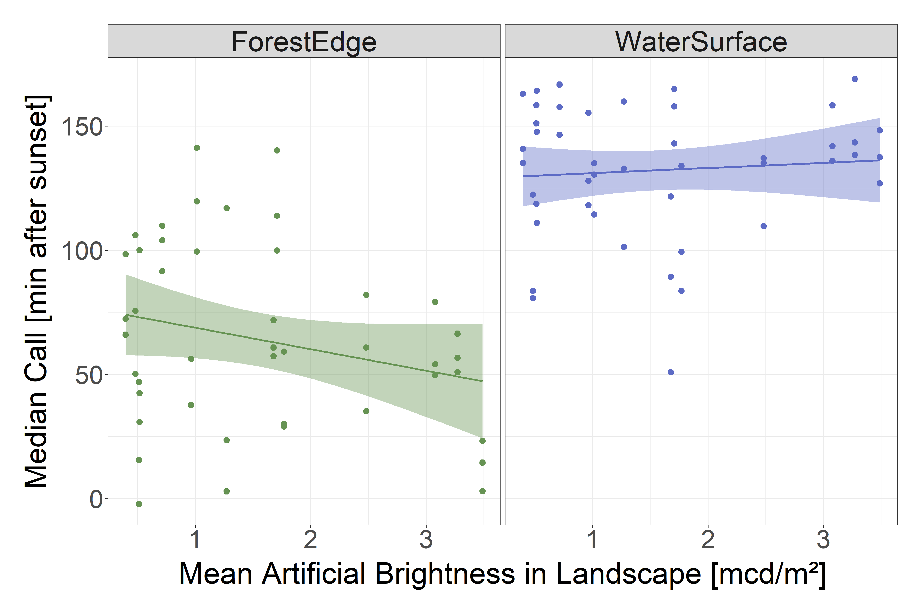
Preliminary (!) results: Median call in first 3.5h
Notes:
Not within confidence interval
Difference between habitats
1h earlier in forest edges,
Also might be already darker in forest edge (data based on satelite measurements)
When brighter outside forest edge difference might be perceived higher
Explore open habitats when darker
Currently no explanation for trend in forest edge

Slide 11
Outlook
Generalise to genus Myotis & compare to P. pygmaeus
Include amount of reed (Biotope SE database)
Analyse different landscape scales
Potentially include feeding buzzes
Finish statistical analysis
Submission of thesis in April 2023

Slide 12
Sources
Falchi et al. (2015): The new world atlas of artificial night sky brightness. https://doi.org/10.1126/sciadv.1600377
Mariton et al. (2022): Even low light pollution levels affect the spatial distribution and timing of activity of a “light tolerant” bat species. https://doi.org/10.1016/j.envpol.2022.119267
Voigt et al. (2021): The Impact of Light Pollution on Bats Varies According to Foraging Guild and Habitat Context. https://doi.org/10.1093/biosci/biab087
Mathews et al. (2015): Barriers and benefits: implications of artificial night-lighting for the distribution of common bats in Britain and Ireland. http://dx.doi.org/10.1098/rstb.2014.0124

Slide 13
Tack för uppmärksamheten
Torge Gerwin
Department of Physical Geography
Stockholm University
contact: toge4438@student.su.se

