Slide 1
Traits contributing to northern distributions in European bats
Katarina Meramo
Svenska Fladdermus- konferensen 2022
Söndag 13 November
Egenskaper som påverkar i fladdermössens nordeuropeiska utbredning

Slide 2
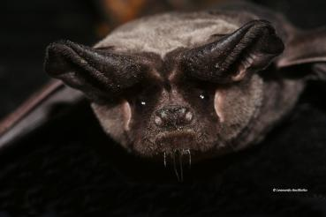
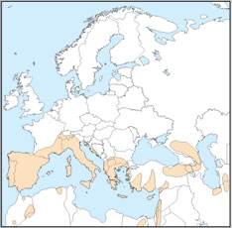
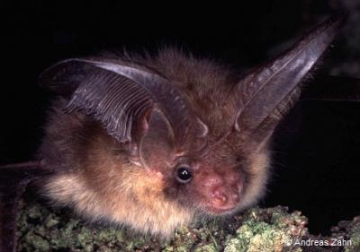
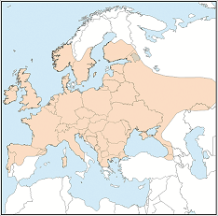
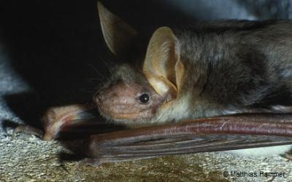
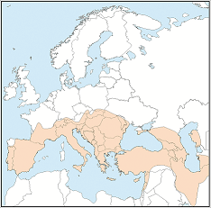
Geographical range size – and why does it matter?
Området var en art förekommer
Biogeographic variable used to determine population abundance and survival
Strong predictor of extinction risk
Bats are widespread but ranges of species varies a lot
Photos and maps: EUROBATS
Plecotus auritus
Tadarida teniotis
Myotis kuhlii
Notes:
When talking about distributions of species, geographical range size, is one of the most important variables (if not the most important)
It is the area across which a species occurs
It is used to determine population abundance and survival
And it is known to be a very strong predictor of extinction risk for example, it is used to assign conservation status of species for the Red List (of the IUCN)
Here we see 3 different European species and not only their range size varies but also their distribution by the latitude

Slide 3
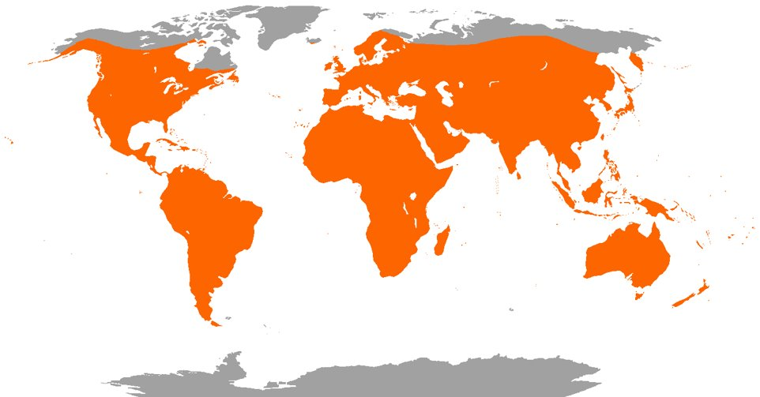
Rapoport’s rule
= Arternas geografiska utbredningsområde ökar på högre breddgrader
Northern Hemisphere
Equator
Southern Hemisphere
Distribution of bat fauna
Notes:
One of the most studied ecological pattern is called Rapoport’s rule It describes a pattern in which range sizes of species increase from low to high latitude, in both northern and southern hemispheres

Slide 4
Rapoport’s rule
Stevens (1989) named the rule after Eduardo H. Rapoport, who had provided evidence for the pattern for subspecies of mammals (Rapoport 1975, 1982)
Generally works out for terrestrial animals
MEN VAD OM FLADDERMÖSSEN?
Notes:
It is named after Eduardo H. Rapoport, who had provided evidence for this pattern for subspecies of mammals (Rapoport 1975, 1982)
For many groups of organisms it doesn't work, such as for marine mammals, but it actually works for terrestrial animals quite well
But we don't have this information for bats

Slide 5
Vad om fladdermössen?
Bats differ from other mammal groups in various ways
Ability to fly → highly mobile
Small but long-living mammals
Winter presents a critical bottleneck for temperate bats
→ Hibernation
Notes:
Because bats differ from other mammal groups in many ways, for example:
True ability to fly which makes them very mobile
Also they are small in size but still very long-living mammals, and this makes them very sensitive to environmental changes for example, winter presents a critical bottleneck
Temperate bats overcome this energy crisis by hibernating over the winter season
These adaptations permit bats access to a wide range of habitats and resources

Slide 6
Rapoport’s rule: some explanations
1. Climatic variability is higher in high latitudes
Only organisms that can survive a broad range of climates will survive
2. Ice age and glaciation (in the Northern Hemisphere)
Only species with a high dispersal ability were able to colonize northern areas
3. Lack of competition in polar areas?
Notes:
Here are the most common explanations for Rapoport’s rule
First one is about climate:
1. Because climatic variability is higher in high latitudes
only organisms that can survive a broad range of climatic conditions will survive → which means these species can also occupy a broader range
2. The second one highlights the efffects of the ice age: Only species with a high dispersal ability were able to colonize northern areas
Does not explain southern hemisphere
Probably still a contributing factor
3. Lack of competition in polar areas?
Because of fewer species, level of competition may be smaller

Slide 7
Kontribution av art egenskaper
Geographical range size: complex interactions between environmental conditions and species traits
Species traits
Physiological, morphological, behavioral or ecological traits
Determine how species can adapt and survive in different environments
Notes:
Soo, as we could notice from the most common explanations I just presented, the geographical range size consists of complex interactions between environmental conditions AND species traits → we need to take into consider also these latter ones
Species traits are any physiological, morphological, behavioral, and ecological traits, which determine how species can adapt and survive in the environment

Slide 8
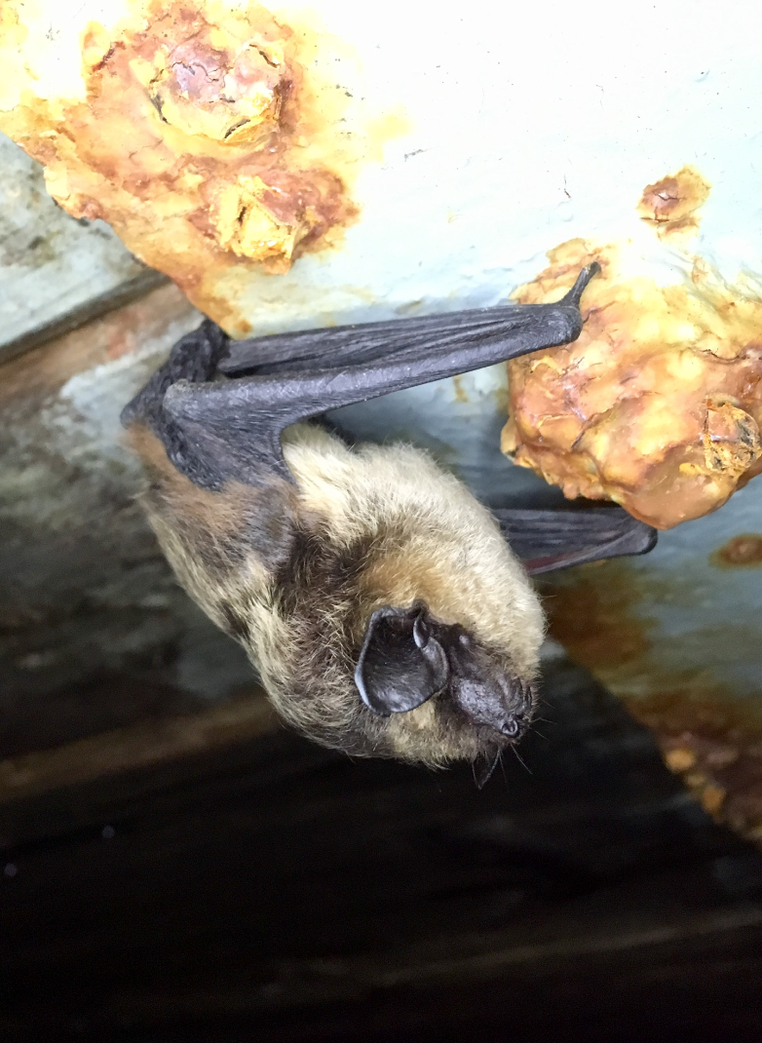
Range size hypotheses based on species traits
The site colonization hypothesis emphasizes the importance of dispersal ability (Hanski et al. 1993)
The niche breadth hypothesis states that the ability to tolerate a broad range of environmental conditions helps a species to have more suitable habitats to occupy (Brown 1984)
Nordfladdermus, Eptesicus nilssonii
Notes:
Ok and then we have a few specific hypotheses to explain how these species traits are relevant for the range size There is this site colonization hypothesis that emphasizes the importance of dispersal ability (which makes sense a lot) Besides dispersal ability, other life history traits may also affect because a species must be able to adapt and survive in the new environment
The niche breadth hypothesis states that the ability to tolerate a broad range of environmental conditions helps a species to have more suitable habitats to occupy, and thus have larger geographic ranges

Slide 9
Research aims – vad ska jag undersöka?
Does Rapoport’s rule work for bats? (= positive relationship between latitudinal distribution and range size)
Do the species traits related to mobility and ability to use a range of different hibernacula affect to the distribution of European bat fauna?
Notes:
Our aim was to investigate whether the Rapoport's rule work for bats (is there a positive relationship between.....)
And, additionally, whether the species traits related to mobility and ability to use a range of different hibernation environments affect to the distribution of European bat fauna

Slide 10
Data set up
Geographical range size and latitudinal distribution (IUCN database) for 46 European bat species
Movement capacity (related to the site colonization hypothesis )
Small (annual movement under 50 km)
Medium (annual movement 50-250 km) or
Large (annual movement more than 250 km)
Hibernation breadth (related to the niche breadth hypothesis)
Based on how many hibernaculum categories a species uses; 1) underground, 2) crevices, 3) trees and 4) buildings
Notes:
We collected our data from open sources. We obtained the geographical range size and distribution variables for 46 European bat species, using IUCN database We got species trait data from many sources but mainly from the Handbook of the mammals (Bat edition) We defined movement capacity for each species, based on their annual movement Then we also defined hibernation breadth for each species
Hibernation breadth tells about species ability to tolerate different environmental conditions and thus is related to the niche breadth hypothesis
We classified different hibernacula into four different categories: 1) underground (caves, mines, cellars and bunkers), 2) crevices (including boulder fields and screes), 3) trees and 4) buildings. Then, we counted how many different hibernacula categories are used by species and gave the 'hibernation breadth' value for each species based on how many hibernaculum categories a species uses

Slide 11
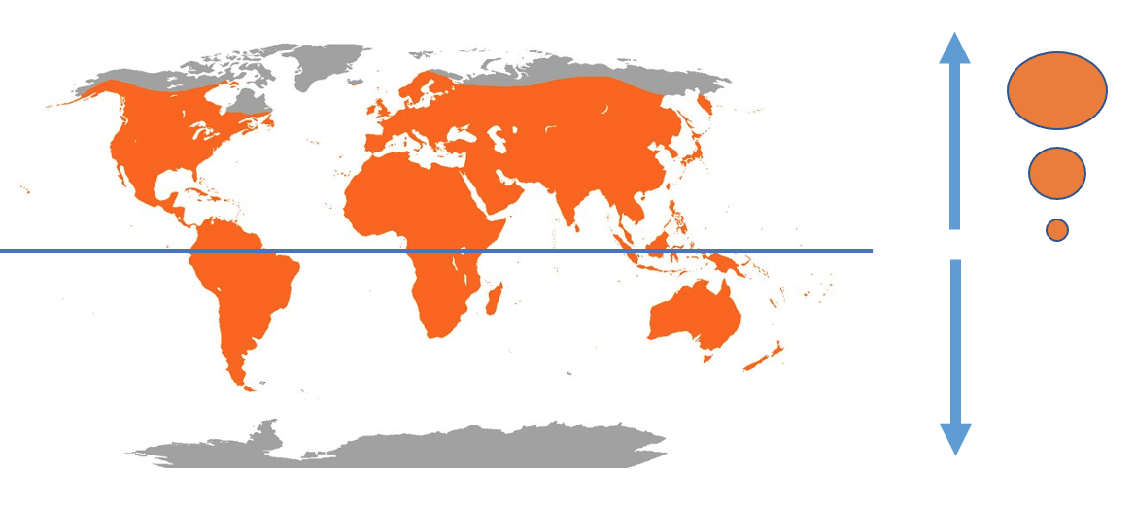
Rapoport’s rule rules for European bats!
= Geographical range size of species increases from low to high latitudes (p-value = 0.0)
Notes:
And we found out that Rapoport’s rule worked out for bats very well
Geographical range size of species increases from low to high latitudes

Slide 12
Additionally… Också…
Also both species traits, mobility and hibernation breadth, explain range sizes of European bat fauna
All statistically significant!
Nordfladdermus, Eptesicus nilssonii
Northern bat, Eptesicus nilssonii​
Notes:
Additionally… Our other independent variables besides the latitude, the species traits, (migration behaviour and hibernation breadth) explain range size in a significant level
And I also want to point out that the Phylogeny of species was considered in our analyses ☺

Slide 13
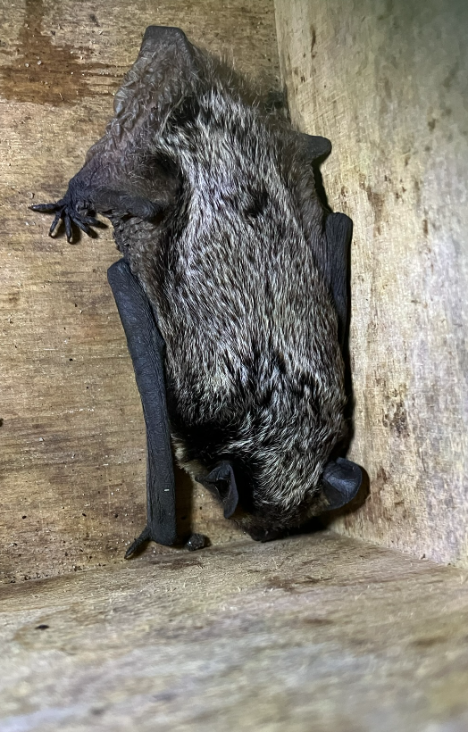
Conclusions 1/2: Northern distribution
The relationship between the range size and the latitude of species distribution very strongly correlated → The same species traits contribute to the northern distribution of bats!
In the North:
Less competition but less resources and winter is tough
Migration and hibernation important adaptations
Gråskimlig fladdermus, Vespertilio murinus
Notes:
First interesting conclusion from our results concerns the northern aspect The relationship between the range size and the latitude of species distribution was very strongly correlated.
From our model, we can draw the conclusion that the same species traits, mobility and hibernation breadth, also contribute to the northern distributions
As we know, there are much less species in our latitudes, which means less competition So the bat species that are highly mobile have a chance to wide their distribution to the north where the competition is less intense, but also different resources, such as hibernation sites, might regionally be less present Migration and hibernation breadth are important adaptations to the northern distributions

Slide 14
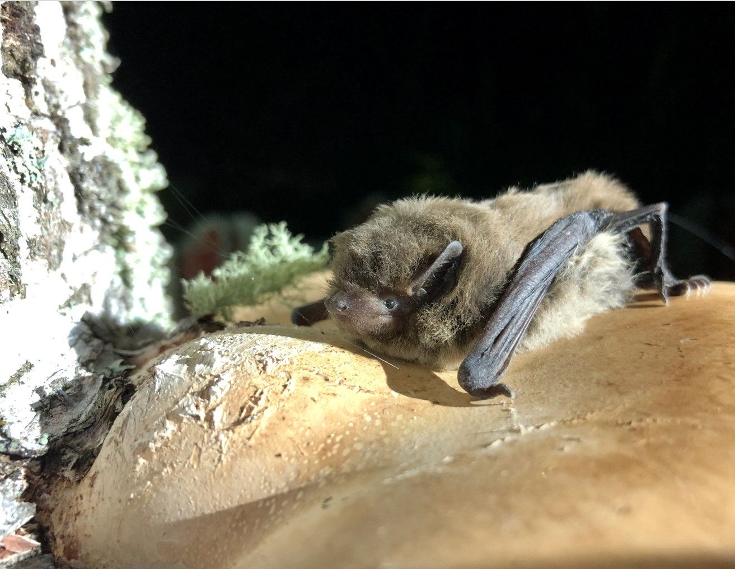
Conclusions 2/2
Information for the conservation of species
Understanding the factors that facilitate species to inhabit wide and high latitudinal ranges also enables to predict shifts in geographic distributions in response to environmental changes
Trollpipistrell, Pipistrellus nathusii
Notes:
The geographic range size offers information about the conservation and management of species due to its relationship with extinction risk and rarity, Also
Understanding which factors frame and facilitate species to inhabit wide and high ranges also enables to forecast shifts in geographic distributions in response to environmental changes, e.g. to climate change

Slide 15
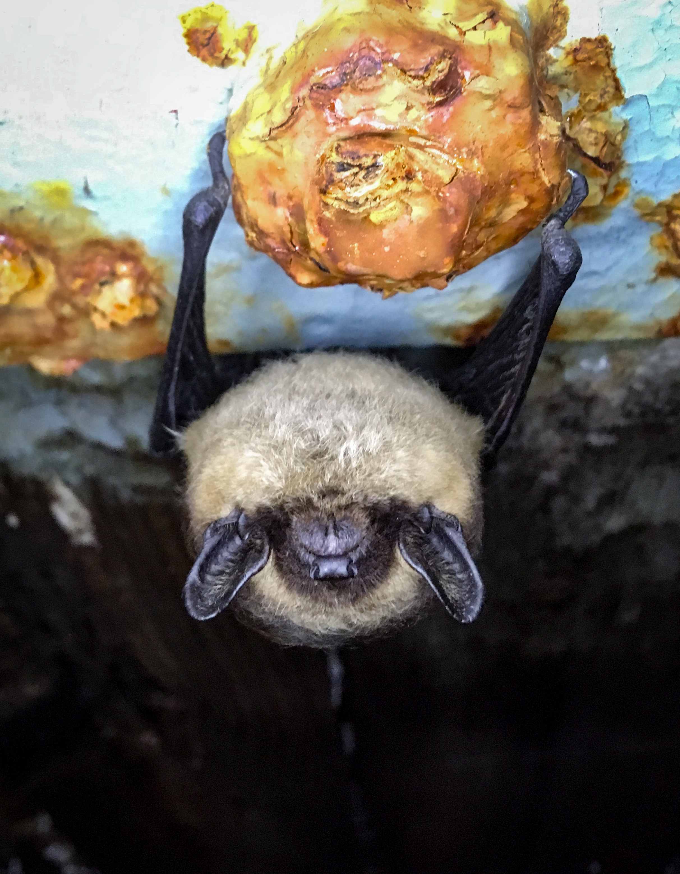
TACK SÅ MYCKET !
Acknowledgments
Thomas Lilley Miika Kotilo Simon Gaultier Piia Lundberg Miina Suutari Otso Ovaskainen Veronika Laine
Notes:
Thank you for listening

