Slide 1
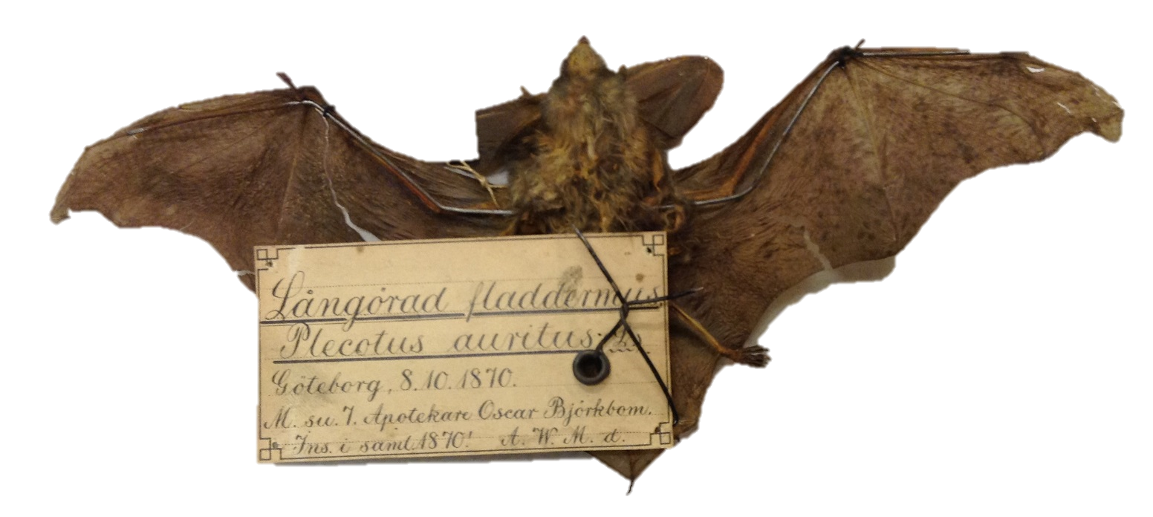
Variability in bat morphology is influenced by temperature and forest cover and their interactions.
Heather Wood
Photo by Jens Rydell

Slide 2
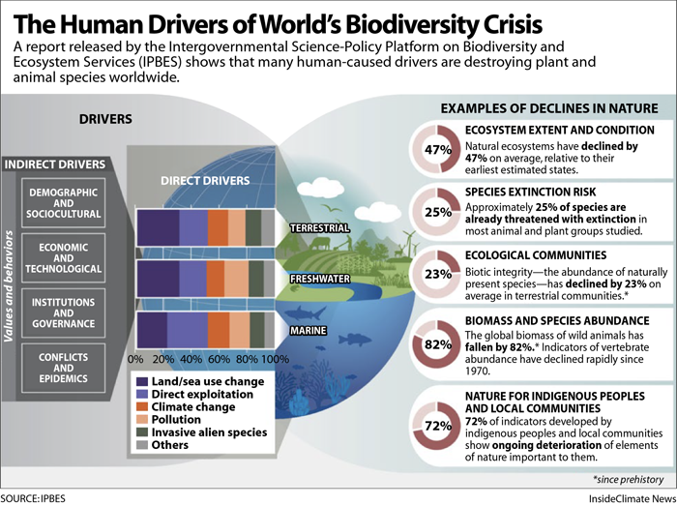
Global drivers of bat populations
Undisputable that environmental change is impacting global biodiversity (IPBES, 2019)
If environmental conditions change species must either:
Disperse
Adapt (e.g. via phenotypic plasticity or genetic evolution)
Notes:
Intergovernmental Science- Policy Platform on Biodiversity and Ecosystem services IPBES

Slide 3
Global drivers in the Swedish conext
Standing volume of trees in forests has doubled in last 100 years
Increase in open land converted to forest
But both cessation of forest grazing in 1940s and increase in plantations has led to species poor dense forests.
Temperatures in northern Sweden have risen by 1.5 to 2 C in last 60 years (Stoessel et al, 2022).

Slide 4
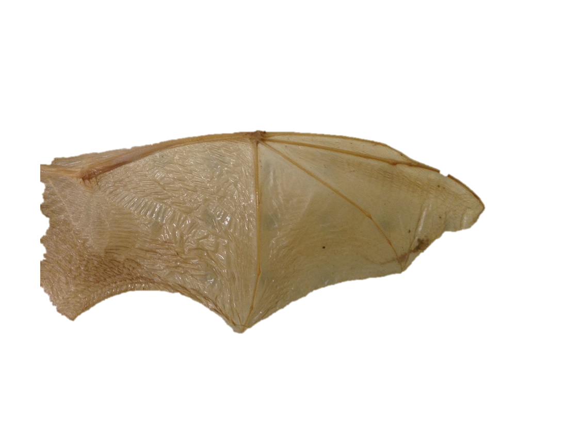
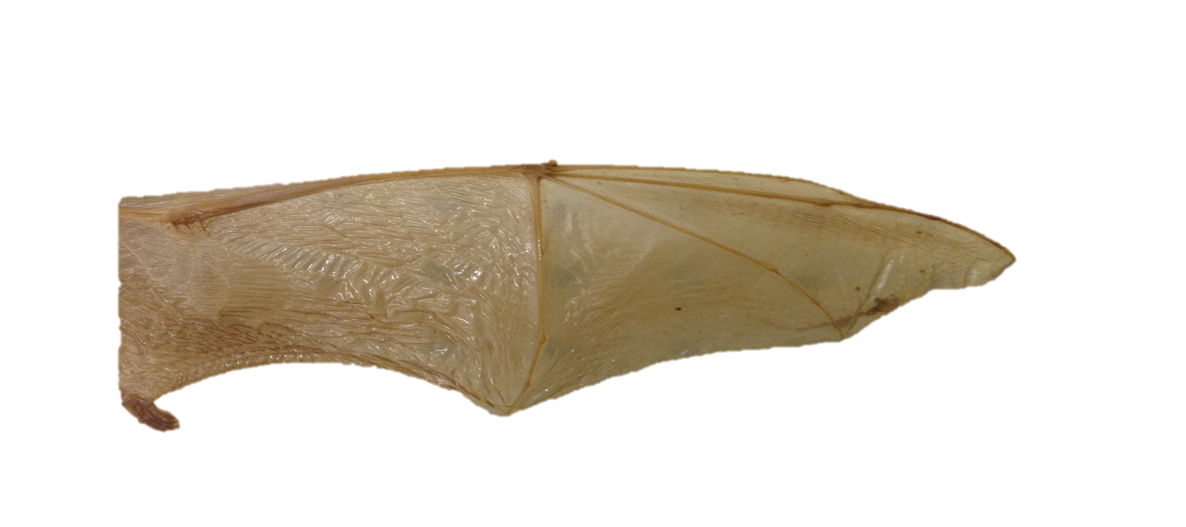
Morphology
Body size
Size of the skull
Size of jaw and teeth
Forearm length
Wing area
Body shape
Wing shape
Wing tip shape

Slide 5
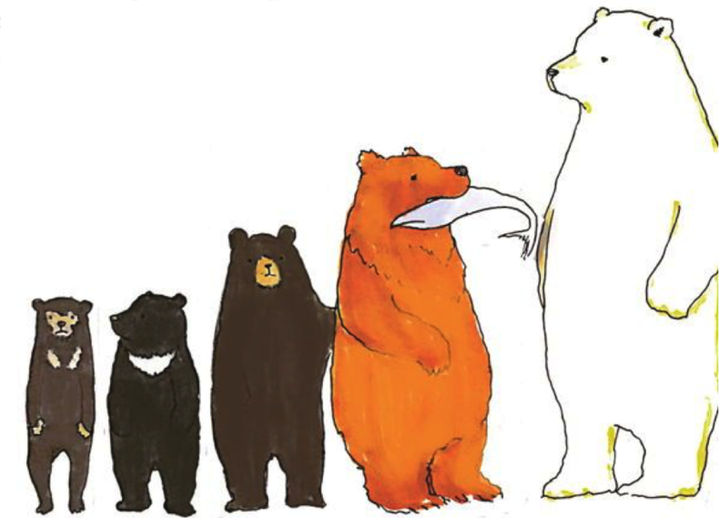
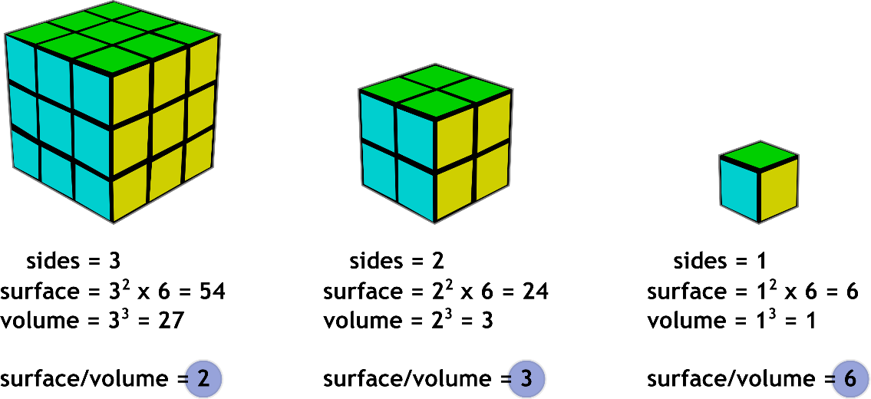
Biogeographical Rules and Morphology
Bergmann’s Rule (1848)
Increasing body size with latitude and altitude
Less heat loss when large
8
8

Slide 6
Biogeographical Rules
Bergmann’s Rule (1848)

Slide 7
Biogeographical Rules
Allen’s Rule (1877)
Larger appendages in warmer climates e.g. beaks, wings, tails.
Large surface area allows heat loss

Slide 8
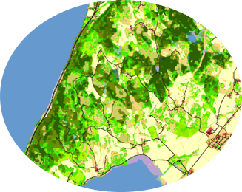
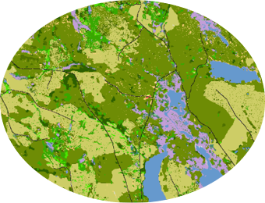
Biogeographical Rules
Resource Rule

Slide 9
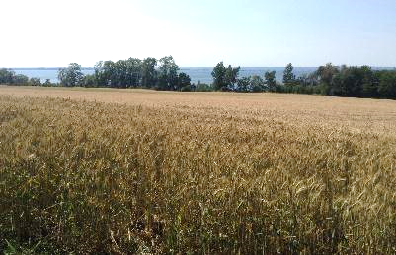
Bat wing morphology- Habitat Adaptation

Slide 10
Bat wing morphology- energy efficiency
Notes:
The shape of wing tips are also important ,with more pointed wings enabling faster flight(Findley, Studier, & Wilson, 1972) and migrant birds with more pointed tips were shown to fly more efficiently at higher speeds (Bowlin & Wikelski, 2008).

Slide 11
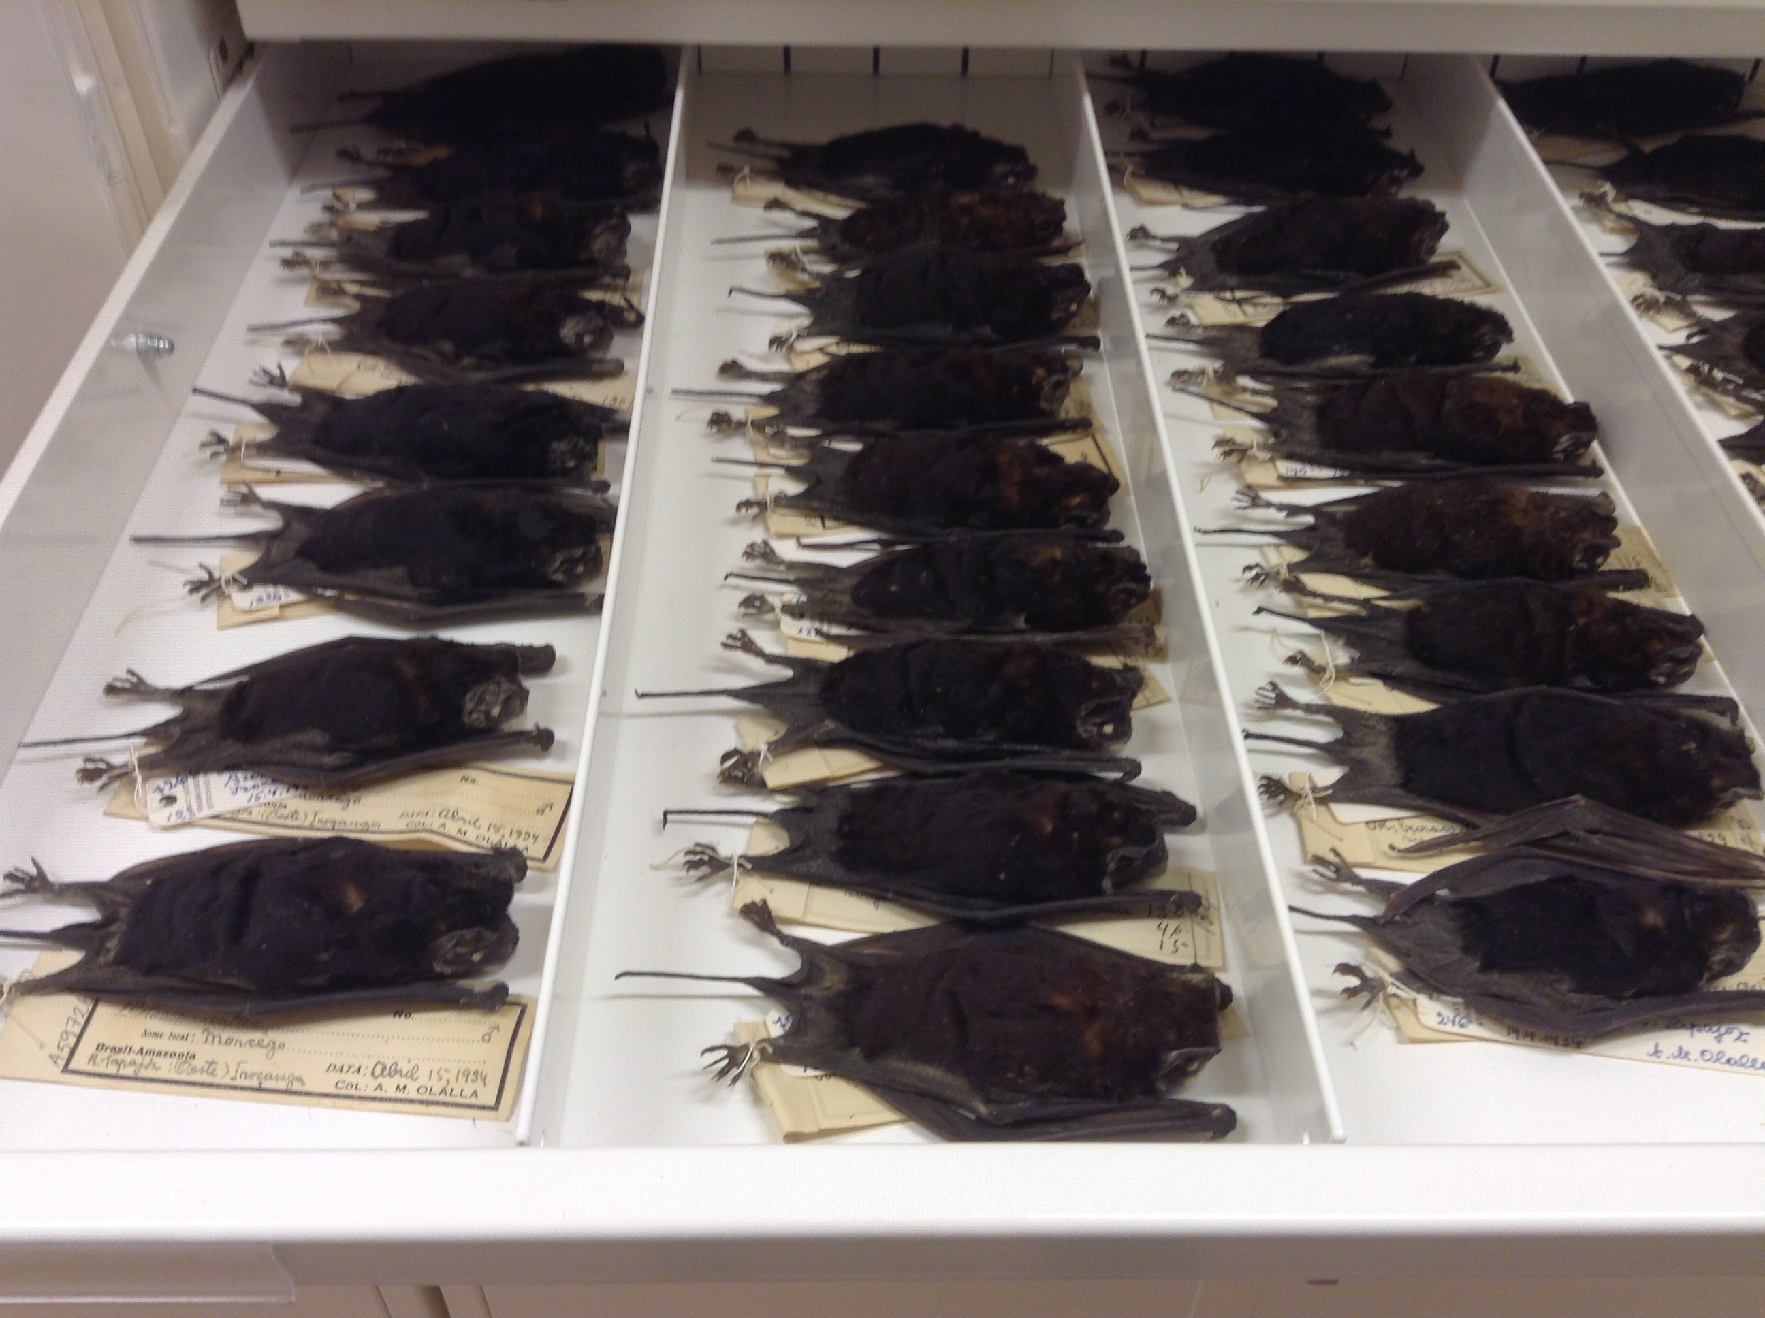
How can we study historic morphological change?

Slide 12
Can rapid morphological changes occur?
Pipistrellus kuhlii in Italy over last 133 years (Tomassini, A. et al (2014) Journal of Biogeography: 41(5))
Bergmann’s rule
Resource Rule
Time
X
✓
Increased street lighting
Notes:
Intergovernmental Scienc- Policy Platform on Biodiversity and Ecosystem services IPBES

Slide 13
Can rapid morphological changes occur?
Cliff Swallow (Petrochelidon pyrrhonota) in Nebraska over 30 years (Brown & Brown (2013) Current Biology 23(6))
Pre- road construction
Post-road construction
Road kill
Surviving wider population
Notes:
Intergovernmental Scienc- Policy Platform on Biodiversity and Ecosystem services IPBES

Slide 14
Global driver data
Many past studies use time as a proxy for climate or land-use change
Some studies included quantitative data for climate OR landscape
But... Very few used measured BOTH climate and historic land-use data
Why is this important?
Both climate and land-use have changed over time so impossible to disentangle the effects of these two drivers.
Climate and land-use could have interacting effects.
Notes:
Intergovernmental Scienc- Policy Platform on Biodiversity and Ecosystem services IPBES

Slide 15
Research Question 1
Higher summer temperatures will cause a decrease in body size (Bergmann’s rule) or an increase in appendage size (Allen’s rule).
Bergmann’s
Allen’s
Notes:
Intergovernmental Scienc- Policy Platform on Biodiversity and Ecosystem services IPBES

Slide 16
Research Question 2
Under a warming climate are bat wings longer and narrower due to the need for energy efficient flight?
Notes:
Intergovernmental Scienc- Policy Platform on Biodiversity and Ecosystem services IPBES

Slide 17
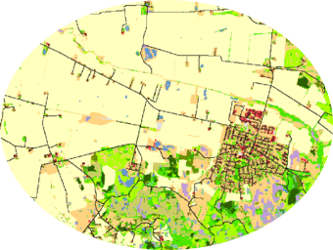
Research Question 3
Bat wings will become shorter, broader and less pointed in response to increased forest cover.

Slide 18
Research Question 4
Is there an antagonistic interaction between the effect of temperature and forest on the shape of bat wings?

Slide 19
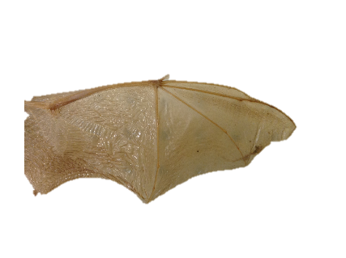
Museum Specimens (1839-2016)
Eptesicus nilssonii 48 96
Pipistrellus pygmaeus 43 149
Plecotus auritus 44 84
Total 135 329

Slide 20
Morphology Measurements
Tip index= D3/FA
Aspect ratio index= (D3 + FA)/D5
Area index = (D3 + FA) x D5 x2

Slide 21
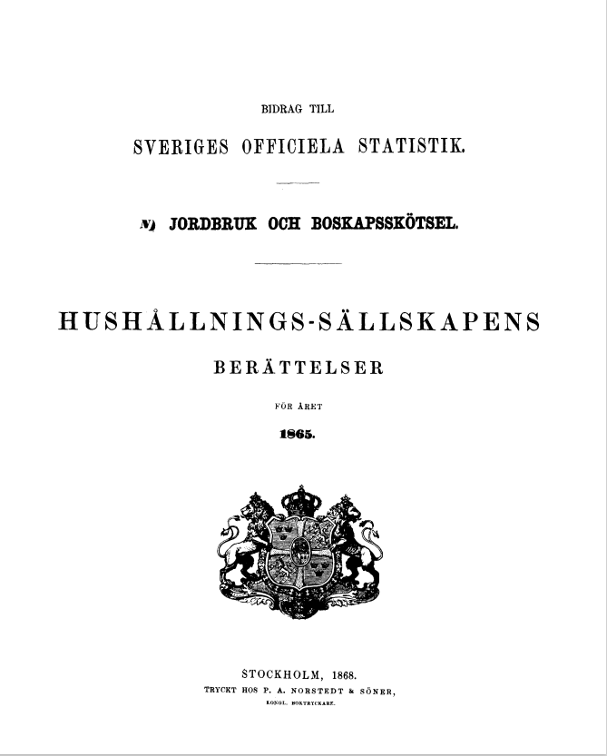
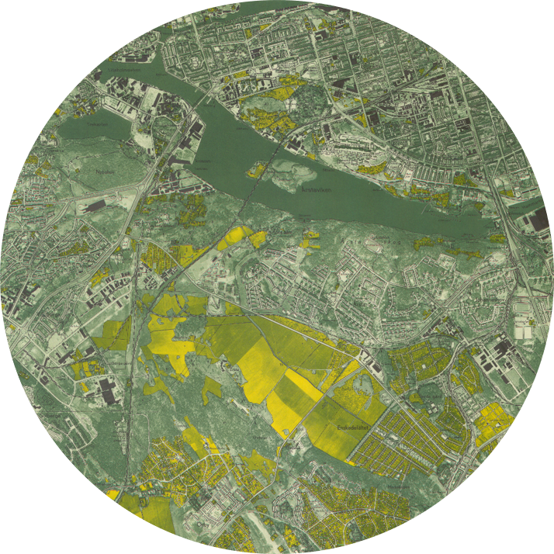
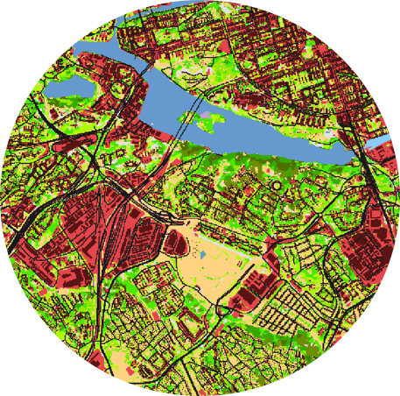
Land-use data
Sweden’s National Statistics
pre 1935
Ekonomiska karta
1935- 1978
Marketäckedata
post 1978

Slide 22
Landscape change
HistMapR
Package in R to digitise historic maps
Auffret et al (2017) Methods in Ecology and Evolution, 8 (11)
2km

Slide 23
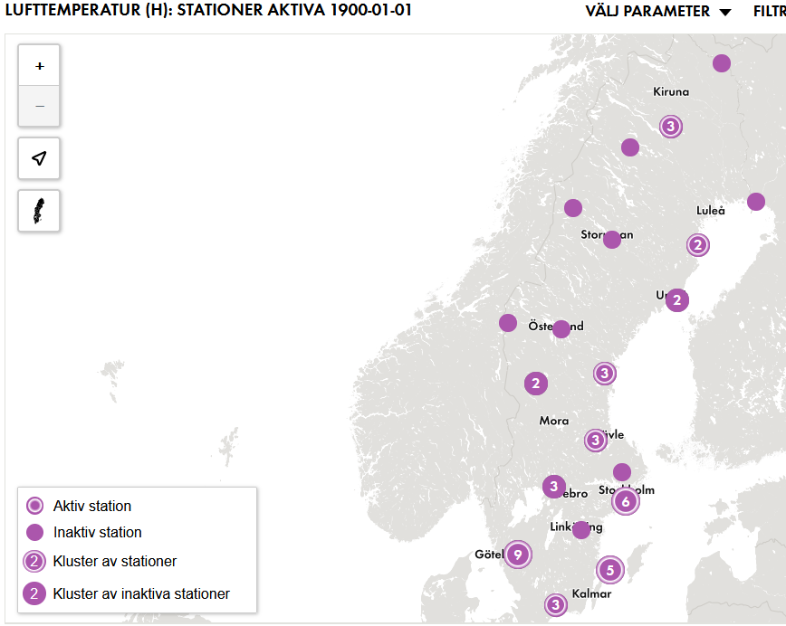
Climate Data
pre 1901
1901-2016
SMHI
CRU TS3.10 Dataset
Summer Monthly Average Temperature

Slide 24
Statistics
Multiple linear regression models
Response Variables
Body size
Crania:
1. PC1
2. PC2
Wing:
3. Wing Area Index
4. Forearm length
Functional Wing traits:
5. Aspect Ratio
6. Tip Index
Explanatory Variables
Summer Average Monthly Temperature
Forest cover
Latitude
Interaction Terms
Year
Forest*Temperature

Slide 25
Results
X
Do higher summer temperatures cause a decrease in bat wing and crania size (Bergmann’s rule) or increase in appendage size (Allen’s rule)?
Bergmann’s
Allen’s

Slide 26
But body size did vary….
Plecotus auritus
Time
PC2
(jaw)

Slide 27
But body size did vary….
Plecotus auritus
Why?
Dietary shift to larger prey items?
Evidence of similar effect in a tropical bat species
expanded primarily moth based diet to include more beetles
P. auritus diet is primarily moths, but second is beetles
Difficult to confirm without historic data on diet
Time
PC2
(jaw)

Slide 28
Research question 2
Under a warming climate are bat wings longer and narrower due to the need for energy efficient flight?
✓
Increased tip pointedness P. Pygmaeus
X
Time

Slide 29
Research Question 3
Are the wings of bats in more forested landscapes shorter and broader in response to the need to navigate clutter?
✓
Pipistrellus pygmaeus
Notes:
Decreasing aspect ratio and decreasing tip

Slide 30
Research Question 4
Is there an antagonistic interaction between the effect of temperature and forest on the shape of bat wings?
✓

Slide 31
Research Question 4
Is there an antagonistic interaction between the effect of temperature and forest on the shape of bat wings?
Pipistrellus pygmaeus
Tip Index
Less pointed wing tips
Interaction:
Forest*Temperature
Tip Index
More pointed wing tips
> 14.5°C

Slide 32
Conclusions
Important to include measured land-use and climate variables
And to explore interactions
Bat morphology varies due to spatial differences in land-use and climate variables.
All three species show ability to adapt
Mechanisms responsible:
-Thermal regulation
-Resource availability (habitat and prey)

